Slide 1
Congratulations! You Got An Interview! – Now What?
By Parin Patel
AMWA
Undergraduate Recruitment Chair

Slide 2
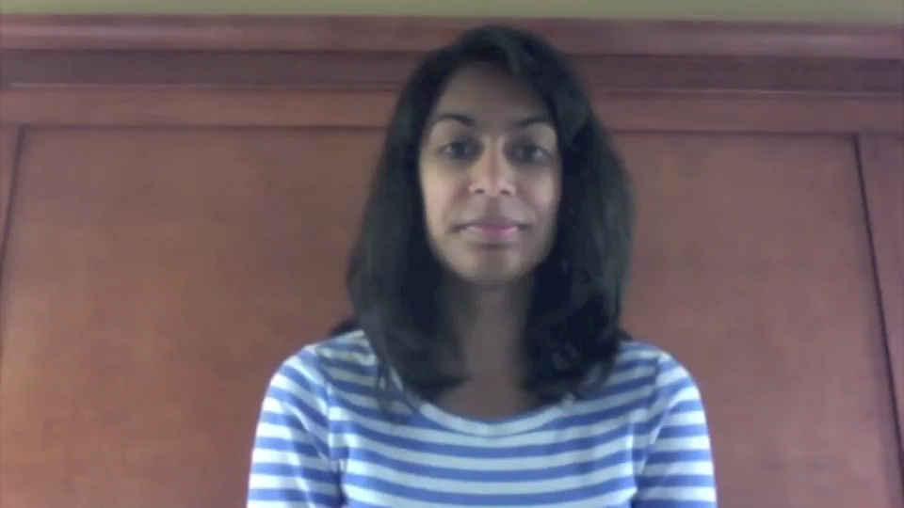
Hello and Welcome!

Slide 3

What To Plan For:
-Prepare for the Interview
-Attire
-Making a Great Impression

Slide 4
Prepare for the Interview
Do your Research!
Know details about the school
Know the Dean of Students and maybe where he/she went to school/what they specialized in
Prepare to answer the most common interview questions
Have questions for the interviewers
Practice with someone
Notes:
-location of program
-type of program/curriculum
-types of volunteer/research/clinical opportunities

Slide 5
Resources
About Medical Schools
Interview Questions
AAMC
Princeton Review
Compare Medical Schools
*some information on these sites may be inaccurate and it’s best to refer to a medical school’s website or admissions department if you have uncertainties
AAMC
Grad School.About.Com
Your School’s Resources & Pre-Health/Pre-Med Departments
Other Schools:
MIT
University of Colorado
Cornell

Slide 6
Attire: Business Professional
Do
Don’t
Neutral dark-colored suit
Men-dress shoes/Women-basic pumps with 1-2” heel
Minimal makeup
Light briefcase/purse or portfolio
Be comfortable
Mismatching suit top and bottom
Over accessorize
Wear torn socks/pantyhose
Have visible body-piercings/art
Wear too much cologne/perfume
Notes:
Colors: black, navy, grey
Skirt should be a little below the knee and never above than knee
Blouses: white, pastel colored, but as along as it’s appropriate
No strappy sandals

Slide 7


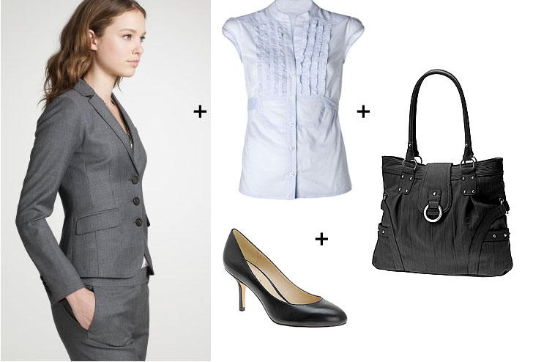
Examples:

Slide 8
Make A Great Impression
Be prepared
Research the school and their offered programs
Prep common interview questions and be knowledgeable about current health-related events
Know the interview location, plan travel to and from the site, and determine housing if necessary
Select attire in advance and make sure it fits and is comfortable – ladies, test out your heels!
Plan to arrive a little early, just to be safe

Slide 9
Make A Great Impression
It’s okay to be a little nervous
Be yourself and be true to yourself. Don’t pretend to be someone you are not because you think it will help – it will not
Watch what you say at all times…my medical school does casual lunch interviews where a current medical student has lunch with an applicant. People say some pretty inappropriate things (one guy discussed enjoying shooting ducks and another made a sexual comment about a student that walked by). Needless to say, they were rejected.

Slide 10
Make A Great Impression
Most importantly, try to relax and enjoy yourself. Good luck!
Take a few deep breaths
Think about something pleasant or calming
Remind yourself that this is survivable and you will get through this day
Plan something fun for after the interview

Slide 11
Questions/Comments/Concerns
Marissa Orenstein, AMWA National Student President
morenstein@amwa-student.org
Jackie Wong, AMWA National Student President-Elect
jwong@amwa-student.org
Parin Patel, AMWA National Undergraduate Recruitment Chair
undergrad@amwa-student.org

