Slide 1
Resume Building
Become a Successful Medical School Applicant
By Parin Patel
AMWA, Undergraduate Recruitment Chair

Slide 2
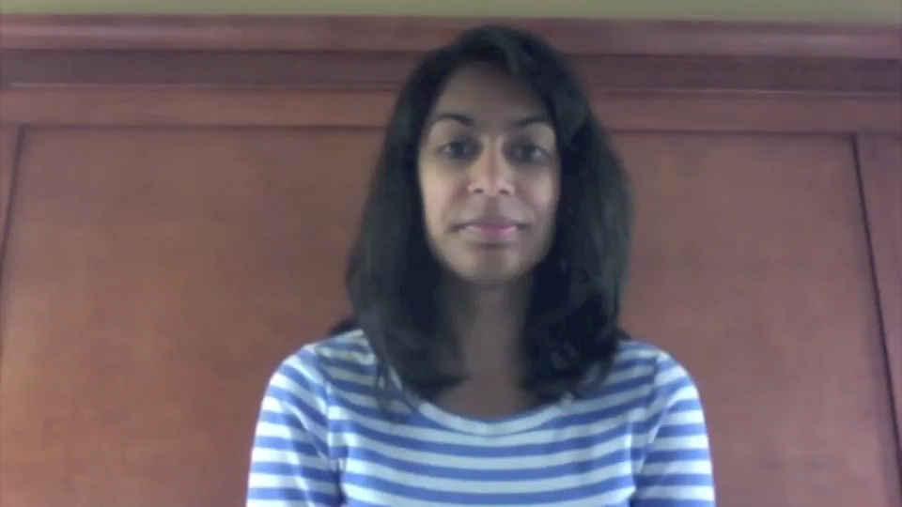
Hello from all of us!

Slide 3
Components
Grades/Scores
Volunteer Experiences
Extracurricular Activities
Research/Work Experiences
Skills, Interests, Values

Slide 4
Grades/Scores
Important!
While it is definitely true that medical school admissions committees review your entire application, a strong GPA and MCAT score will only strengthen your application

Slide 5
Grades/Scores
Some schools have minimum GPA and/or MCAT score requirements
Average GPA and MCAT scores of current students vary for each school
See AAMC’s MSAR for schools’ specific requirements

Slide 6
Volunteer Experiences
Health Related
Non-Health Related
Hospital
Medical Organizations: American Red Cross, Unite for Sight, AMWA
Nursing Homes/Assisted Livings
Working with Children (Tutoring/Mentoring)
Working with Animals
Advocacy/Human Rights
Religious Organizations/Team Volunteering
Disabilities (Learning or Physical)

Slide 7
Volunteer Experiences
Local
Abroad
Advice work (Hotlines)
Summer camps
Habitat for Humanity
Health-related work
HIV/AIDS programs
Habitat for Humanity
Notes:
Conservation, gardening, environment
Health-related
Volunteerhq.org
UniteforSight.org
CrossCulturalSolutions.org
Gviusa.com
Isvolunteers.org

Slide 8
Extracurricular Activities
Get Involved with Something You are Passionate About | Activities Do NOT Have to be Medically-Related
Be Involved with Events, Take on Responsibilities and Leadership Positions if Possible | Don’t Just Join a Group
Don’t Pile on More than You can Handle | Consider Committing Long-Term to a Few Groups vs. Working on Many Short-Term Projects

Slide 9
Research/Work Experiences
Participate in research or work opportunities if:
  you are truly interested in these projects
  feel you can learn something from this experience
  you can contribute or offer something to the research or at the work-place
Health-related experiences are beneficial, but not required
Be able to explain your specific role and contributions

Slide 10
Skills/Interests/Values
These qualities show your uniqueness and demonstrate how you might contribute to the field of medicine in a non-traditional way
Try to only include information that can be medically applicable
Ex: languages spoken, CPR or EMT training

Slide 11
Questions/Concerns/Comments
Marissa Orenstein, AMWA National Student President
morenstein@amwa-student.org
Jackie Wong, AMWA National Student President-Elect
jwong@amwa-student.org
Parin Patel, AMWA National Undergraduate Recruitment Chair
undergrad@amwa-student.org

