Slide 1
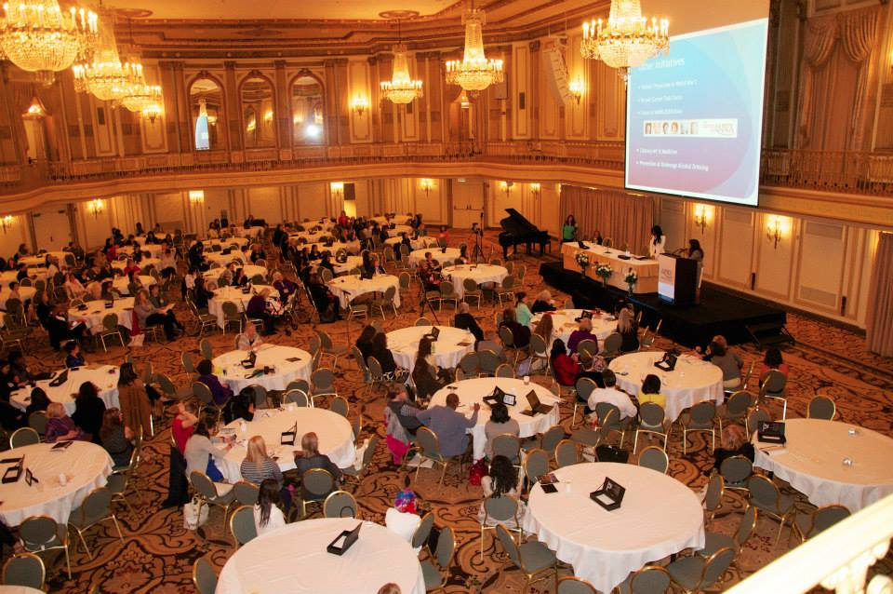

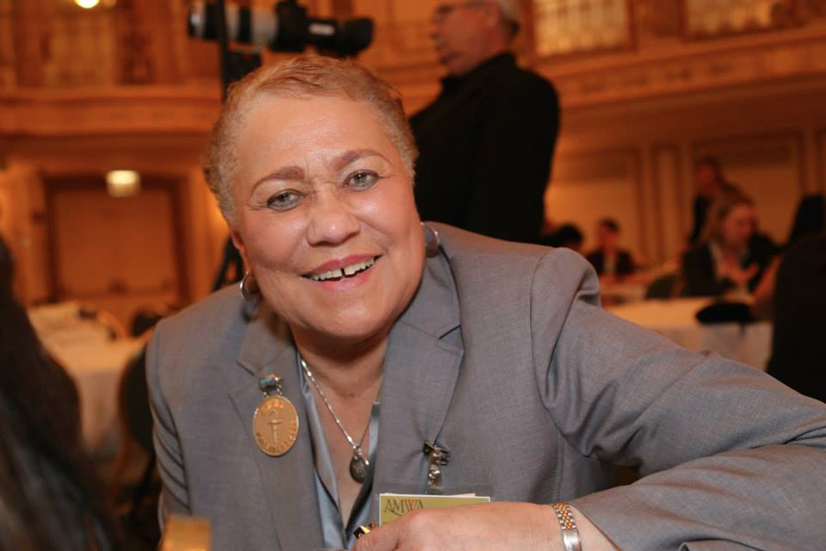
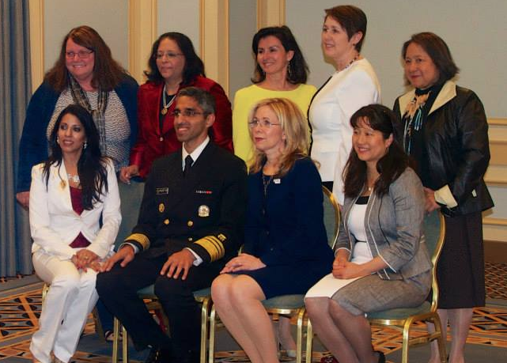

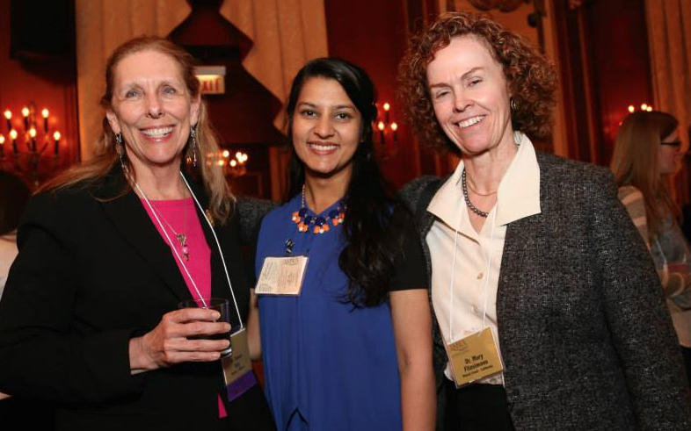

Women in Medicine Mentoring Reception
SAVE the DATE
Wednesday, September 30, 2015
5-7:30pm
Albert Sherman Center (1st Floor Multi-purpose Room)
All MS years welcome.
Want more info? >>>> email: Leadership@yourMedSchool.Edu
You don’t want to miss this….

