Slide 1

www.amwa-doc.org

Slide 2
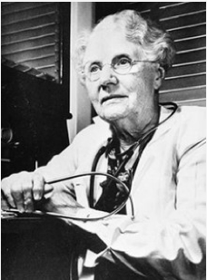
History of AMWA
In 1915, Dr. Bertha Van Hoosen, a Chicago surgeon, gathered women physicians together for networking and support. That was the beginning of the American Medical Women’s Association.
At the time of AMWA’s founding, only 5–6% of physicians were women.
Despite immense progress, there continues to be a pressing need for female role models and mentors, specialized professional development, and increased study of women’s health issues.
AMWA meets your critical needs now and in the future! Join today with other women physician leaders and make a difference in your professional life tomorrow.
Visit www.amwa-doc.org/about-amwa/faces-of-amwa/ to learn more about Dr. Van Hoosen

Slide 3

Why is AMWA Important?
American women who work as physicians made $50,000 less annually in 2010 than their male counterparts,
Women make $350,000 less over a 30 year career than men.
Women account for one-third of all doctors and half of medical school students.
The overall gender wage gap means that on average women make just 77 cents for every dollar a man earns.

Slide 4
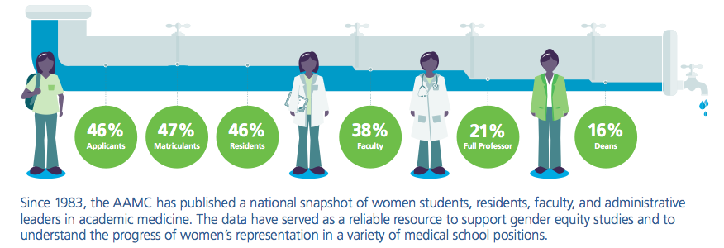
Women Physician in Leadership
AAMC 2013-2014 Report on the State of Women in Academic Medicine

Slide 5
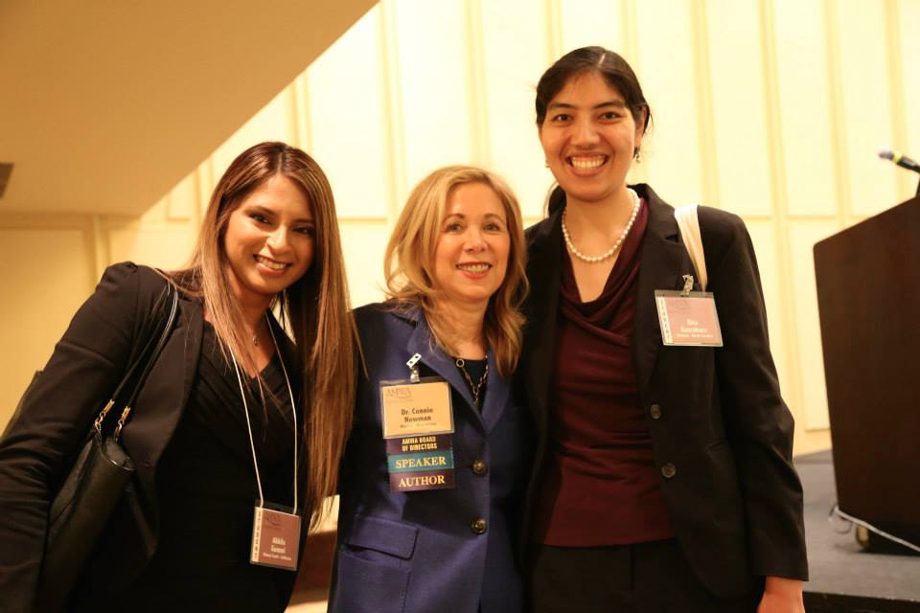
What is AMWA?
The American Medical Women's Association is an organization which functions at the local, national, and international level to advance women in medicine and improve women's health.
We achieve this by providing and developing:
Leadership
Advocacy
Education
Mentoring
Strategic alliances

Slide 6
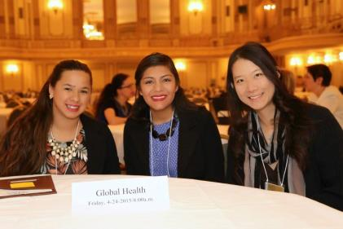
Our Goals
To promote and foster women students as leaders in medicine and to establish a network and support system for personal & career development
To empower women to take the lead in improving health for all, within a model that reflects the unique perspective of women

Slide 7


Student Benefits!
15% off MDpocket clipboards and products
15% off Cram Fighter study planner
Receive $10 towards your school's AMWA branch for every new national member sign-up between August 1 to September 30, 2016 (50% as cash and 50% as AMWA merchandise credit)
For a full list of our partners visit: www.amwa-doc.org/students/partnerships/

Slide 8
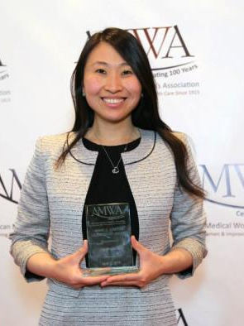
Scholarships
Medical Education Scholarships
Membership Fee Waiver
Kaplan Scholarships
Linda Brodsky MD Essay Award
Heller Outstanding Branch Award
Anne C. Carter Global Health Fellowship
Anne C. Carter Leadership Award
Eliza Lo Chin Unsung Hero Award
Young Women in Science Awards
Poster Presentations
Jim Heller Annual Meeting Travel Grants
Service Recognition Award
Overseas Assistance Grants
Child Family Health International Global Health Education Program Scholarship
Ponce Health Sciences University Global Leadership Conference Scholarship
For more info visit: www.amwa-doc.org/students/awards/

Slide 9


Slide 10
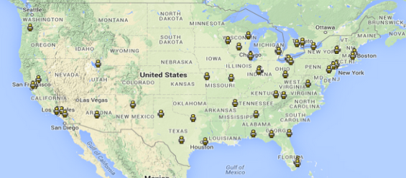
Mentorship
AMWA Charlotte Maguire Mentorship Database
Member exclusive online database (log-in only)
Access to physicians and students across the country!
Email, location, institution, interests within medicine
Sign up today!
Visit: amwa-doc.org/mentorship for more information!

Slide 11
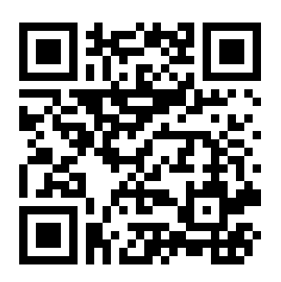
Sign Up Now!
Visit: https://www.amwa-doc.org/membership-registration/
$25
Premeds: $50
Med Students: $75
Residents: $50

Slide 12

Join AMWA Student Division
for a discounted rate of $50 NOW
August 20 to September 30, 2016
But there’s more…
Between the months of August – September 2016:
Receive $10 towards your school's AMWA branch
for every new national member sign-up *
*To redeem this offer, branch presidents will fill this form at the end of the recruitment season. We will respond within 2 weeks letting you know the amount of cash and merchandise credit you should expect to receive.

Slide 13




Connect With Us!
American Medical Women's Association / AMWA
@AMWADoctors
@AMWAStudents
amwadoc
Questions? Email President@amwa-student.org

